Slide 1
Environmental Policy

Slide 2
Environmental Policy
As experience hoteliers we recognise that our operations have an effect on the local, regional and countywide environment. As a consequence of this, the management and directors are committed to continuous improvements in environmental performance and the prevention of pollution. Environmental regulations, laws and codes of practice will be regarded as setting the minimum standards of environmental performance.
The General Managers are responsible to the Board for the company’s performance and implementation of this policy. The General Managers will be supported by a nominated specialised (or company) who will provide regular reports on progress.
Overview of the Strategy and Action Plan
1.Expert assistance has been set up to lead activity on a range of objectives. The steering group will develop and maintain activity on the action plan. The objectives and action plan will be communicated to all employees.
2.The Green Tourism Business Scheme (audit and grading ) has been established as the key framework for assessing performance and monitoring improvements. Employees and suppliers will be directly impacted and our customers will be encouraged to support initiatives.
3. The main focus is on reducing consumption and improving efficiency in our Energy and Waste Management processes. Targets for each business are set for reducing energy, waste and water consumption. These targets are treated as Key Performance Indicators when reviewing local management performance.

Slide 3
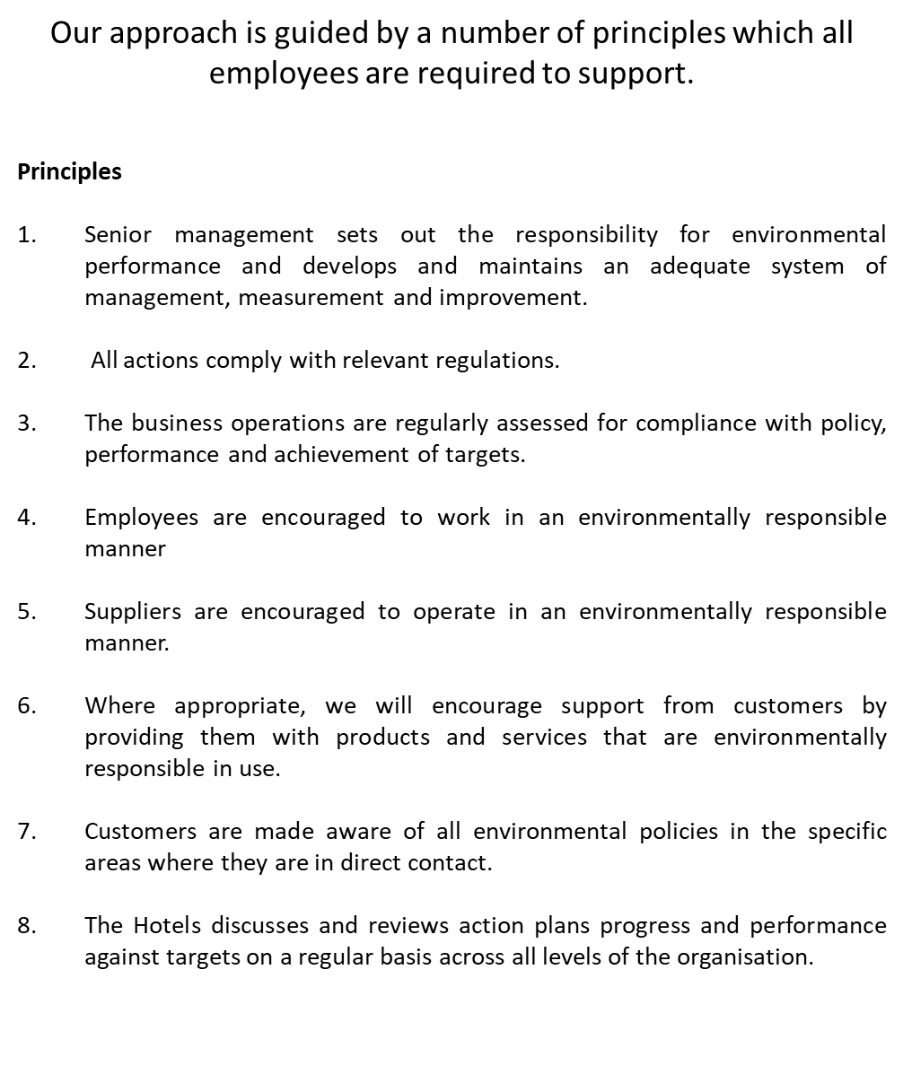

Slide 4
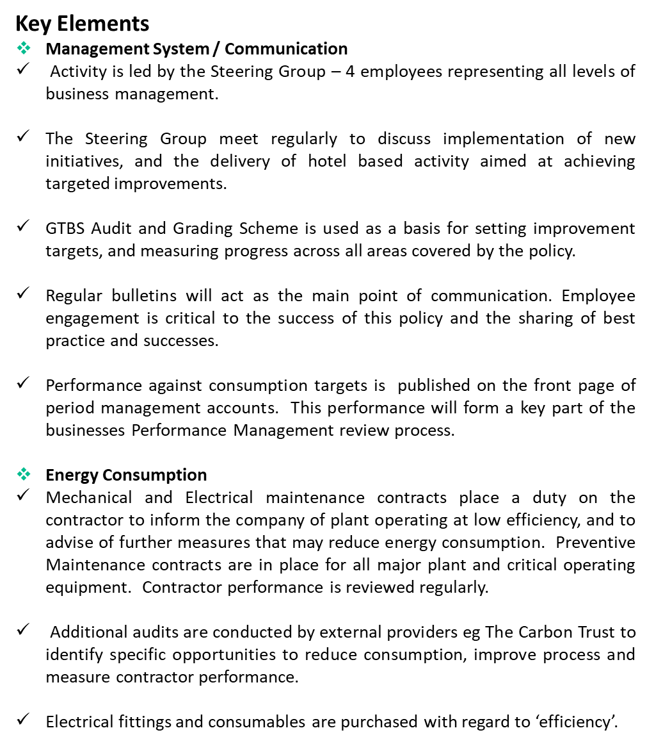

Slide 5
